Slide 1

COM410 Programming in Practice
Sorting

Slide 2


Reach Out
Email:
serif.salem@qa.com
Serif Refined Material (Password: COM410)
https://tinyurl.com/QACOM410
University Drop Box
https://tinyurl.com/QAULSTER

Slide 3
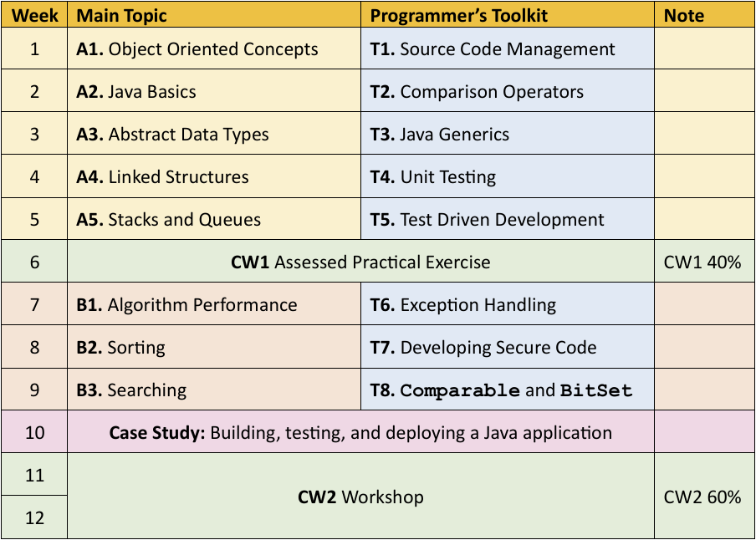
Module Structure and Assessment

Slide 4
Some Fundamentals of Java

Slide 5
Java Packages
A package in Java is like a folder that groups related classes, interfaces, and sub-packages together. It helps you:
Organize your code
Avoid naming conflicts
Control access to classes and methods
Reuse code more efficiently
Java packages fall into three main categories:
Built-in Packages: Provided by Java itself as part of the JDK and available when you install Java.
Such as java.util, java.time, ….etc.
Third-party Packages: Created by others (developers or libraries) using tools such as Maven.
Such as com.google.gson that convert Java objects to/from JSON
User-defined (Own) Packages: Created by you or your team to organize your code.

Slide 6
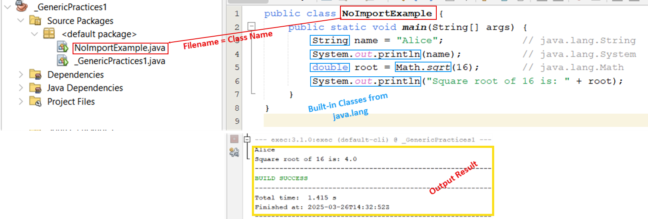
Java Packages – java.lang
When you write a Java program, the compiler automatically includes everything in the java.lang package — no need to manually import it.
java.lang contains the core classes that Java believes every program needs.
Classes in java.lang | What it does
System | Input/output, environment access
String | Text handling
Math | Math functions (e.g. Math.sqrt())
Object | The root class of all classes
Thread | Multithreading support
Exception | Exception handling
Integer, Double | Wrapper classes for primitives

Slide 7
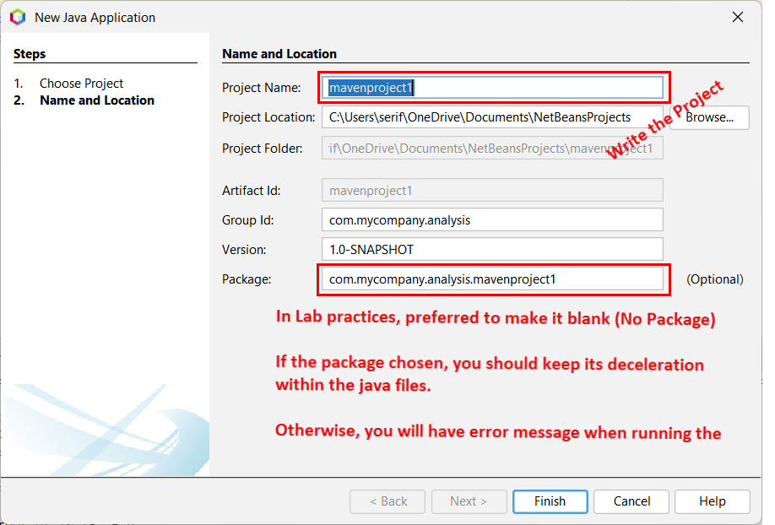
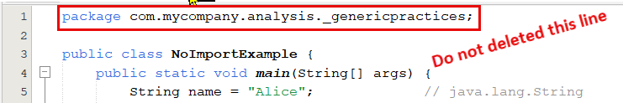
Java Packages – Create New Project
File → New Project → Java Applications → Next..
This is a package declaration — it tells Java which folder (or namespace) this file belongs to.
Helps with project structure and access control.

Slide 8
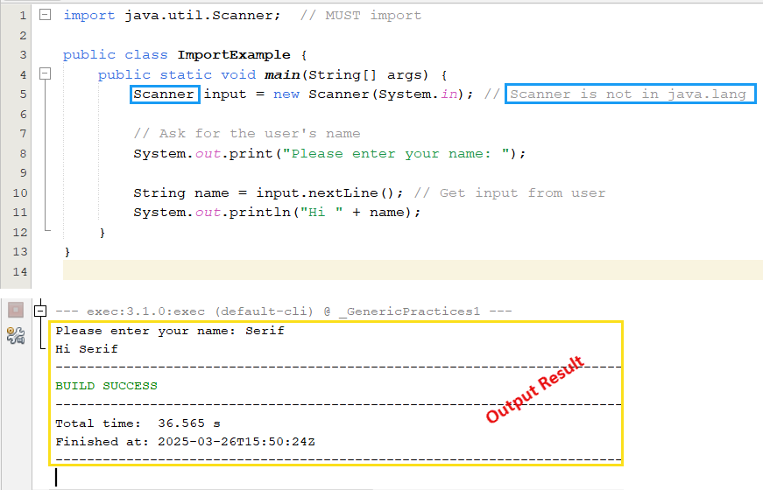
Java Packages – import java.util.Class/Interface
java.util is a built-in Java package that contains utility classes and interfaces, especially for:
Must import the proper class/interface whenever used in your java file.
import java.util.Scanner; //Import Scanner
Import jave,util.*; //import everything in java.util
Not recommended.
Category | Examples
Collections | ArrayList, HashMap, HashSet
Input | Scanner
Date & Time (old) | Date, Calendar
Randomness | Random
Utilities | Collections, Optional

Slide 9
Classes and Interfaces
A class in Java is a blueprint for creating objects. It defines "What an object is and what it can do.“: 1) Fields (data), 2) Methods (behaviors), 3) Constructors (initialization logic).
An interface in Java defines a contract: it declares methods that must be implemented by any class that uses it. Interfaces are about what a class can do — not how.
Key Differences Between Class and Interface
Feature | Class | Interface
Contains | Fields + Methods + Constructors | Only method signatures (and constants)
Can be instantiated | ✅ Yes | ❌ No (cannot create an interface object)
Inheritance | Single inheritance only | Multiple interfaces can be implemented
Methods | Concrete methods | Abstract by default (can have default/static)
Fields | Can be instance or static | Only public static final (constants)

Slide 10
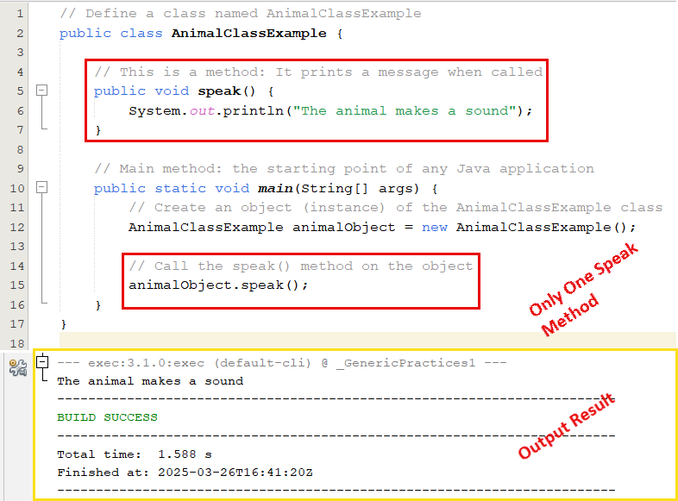
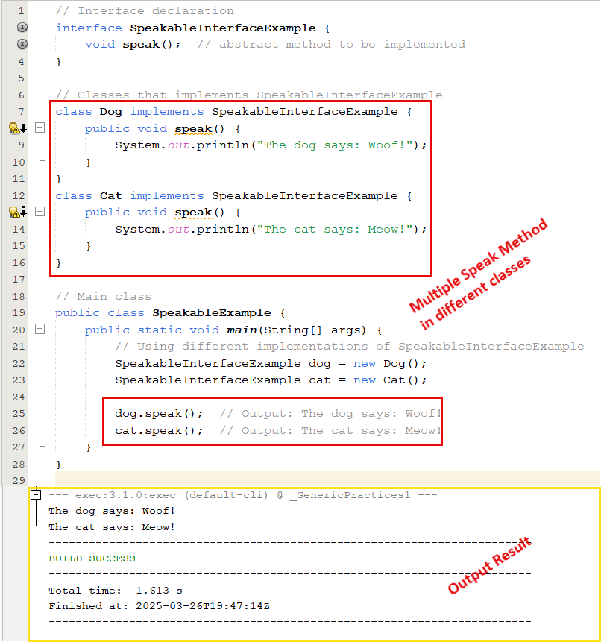
Classes and Interfaces

Slide 11
Interfaces Practice
For the interface “SpeakableInterfaceExample”
Create new abstract method called food.
In the class implement the food interface for both the cat and dog
And print out the results.

Slide 12
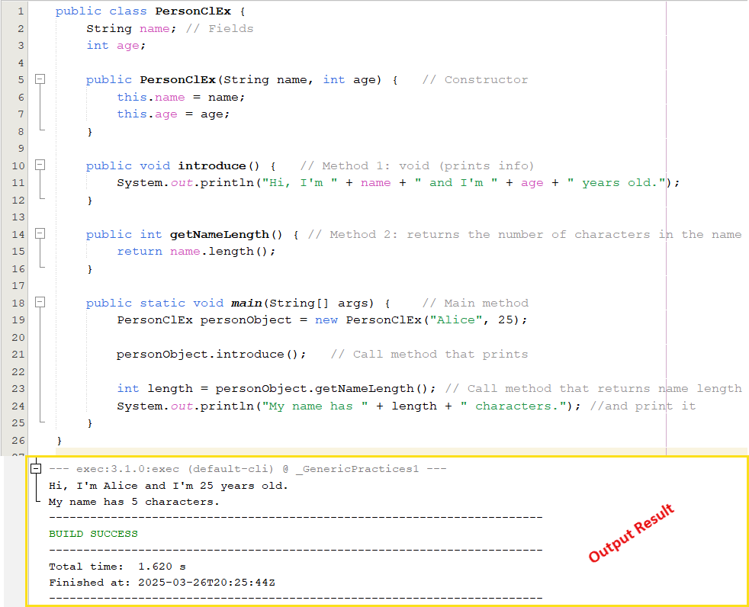
Java Class - Structure
Part | Example | Purpose
Class | public class Person | Defines the class
Field | String name; int age; | Stores data
Constructor | public Person(String n, int a) { ... } | Initializes the object
Method | public void introduce() { ... } public int getNameLength() { ... } | Adds behavior
Main Method | public static void main(...) { ... } | Runs the program
Object Creation

Slide 13
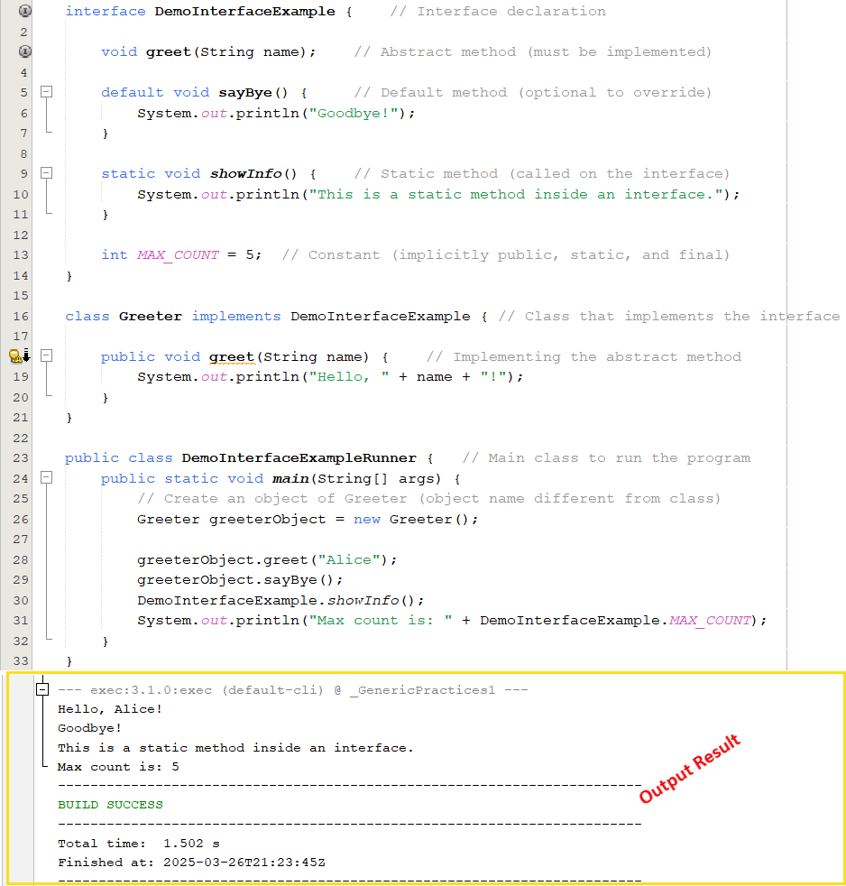
Java Interface Structure
Component | Description | Example
Interface Declaration | Declares the interface using the interface keyword | public interface DemoInterfaceExample
Abstract Method | Declares behavior that must be implemented in any class that uses the interface | void greet(String name);
Default Method | Provides a method with a default implementation (can be overridden) | default void sayBye() { ... }
Static Method | Provides utility logic; belongs to the interface itself | static void showInfo() { ... }
Constant | A public static final variable (implicitly so in interfaces) | int MAX_COUNT = 5;

Slide 14
Main Class - public static void main(String[ ] args)
public static void main(String[] args) is always written in the main class.
It is the entry point of every standalone Java program.
When you run a Java program, the Java Virtual Machine (JVM) looks for this exact method to start the execution.
Think of this command as the front door to your program.
If it's missing or misnamed, the JVM doesn't know where to start — you'll get an error.

Slide 15
Recap (Queues and Stacks) Case Study - Playing Cards

Slide 16
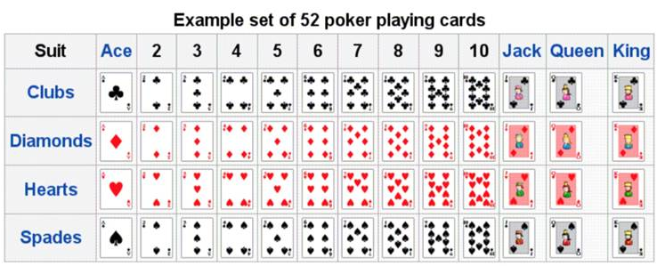

Case Study – Playing Cards
Playing cards provide an excellent example of an ADT that can support multiple applications
Suit (Hearts, Spades, Clubs, Diamonds)
Rank (2, 3, 4, …, Queen, King, Ace)
Value (2, 3, 4, …, 9, 10, 10, 10, 10, 11)
Rank Value (e.g. 0, 1, 2, …, 10, 11, 12)
Colour
Face up/face down
Collection of cards can be a deck (1 only?)
Collection of cards can be a hand (multiple?)
Cards behave differently in different situations (Snap, Poker, Bridge, etc.)
Standard operations – deal, shuffle, compare, etc

Slide 17
Scenario – Playing Card (Lab)
In your DataStructures project, implement a Card class to represent a single standard playing card.
A card is characterised by 2 values
Its rank (one of “2”, “3”, “4”, “5”, ”6”, “7”, “8”, “9”, “10”, “Jack”, “Queen”, “King”, “Ace”)
Its suit (one of “Clubs”, “Diamonds”, “Hearts”, “Spades”)
Include the following public methods on Card objects
A Card() constructor to generate a card with random rank and suit values
Accessor methods getRank() and getSuit() to return the rank and suit
A toString() method to return the card in the form (e.g.) “2 of Clubs”
A method isBiggerThan() that takes another Card object as a parameter and returns true if the card has a higher rank than the parameter card.
Implement a CardTest class to generate 2 new cards and display them biggest first

Slide 18
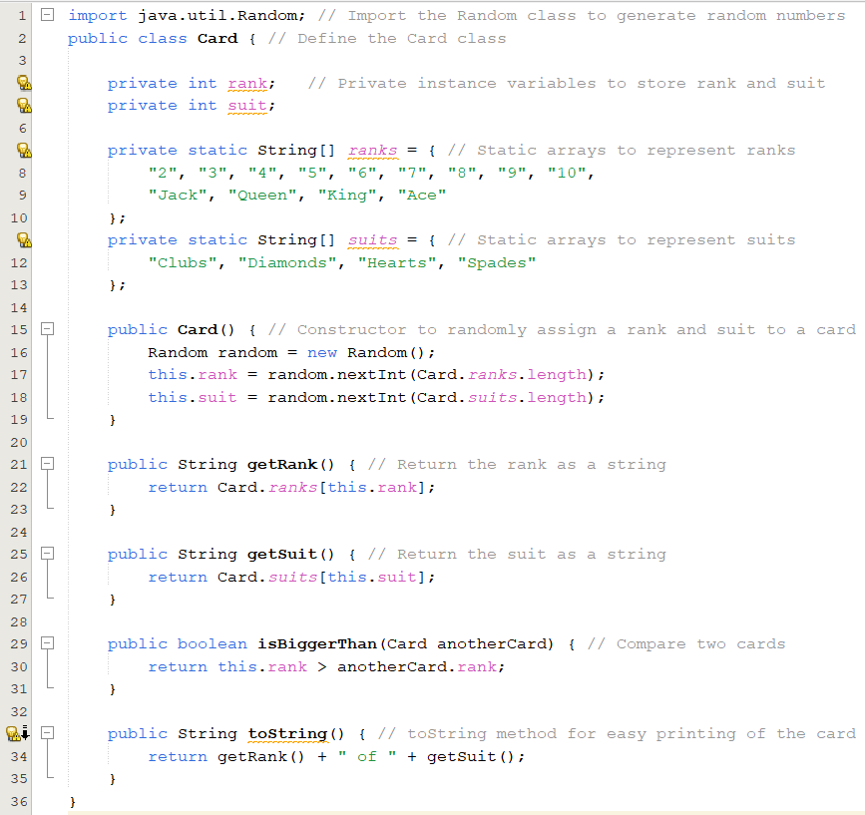
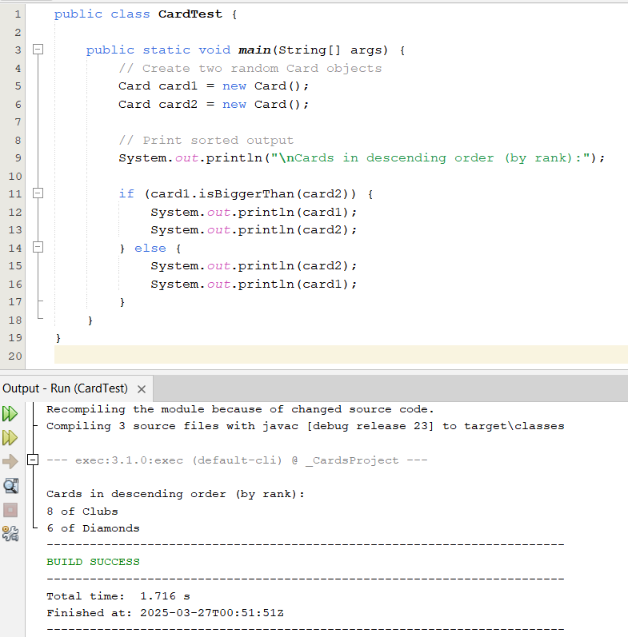
Card.java and CardTest.java

Slide 19
Scenario – Playing Card (Lab)
In your DataStructures project, create the class Deck to represent a full pack of 52 Card objects.
Provide a method toString() The deck should create one of each combination of suit and rank. You will also need to create an overloaded Card constructor that accepts rank and suit parameter values.
Provide a method toString() that returns a string representation of the deck, with each card printed on a separate line.
Provide a method deal() that returns a Card object and removes it from the deck
In the CardTest class, provide code to create a deck, print it, and deal and print 5 cards
Provide a method shuffle() that randomizes the order of the cards in the deck
In the CardTest class, demonstrate that the shuffle has had an effect by creating a deck and printing it to the console.

Slide 20
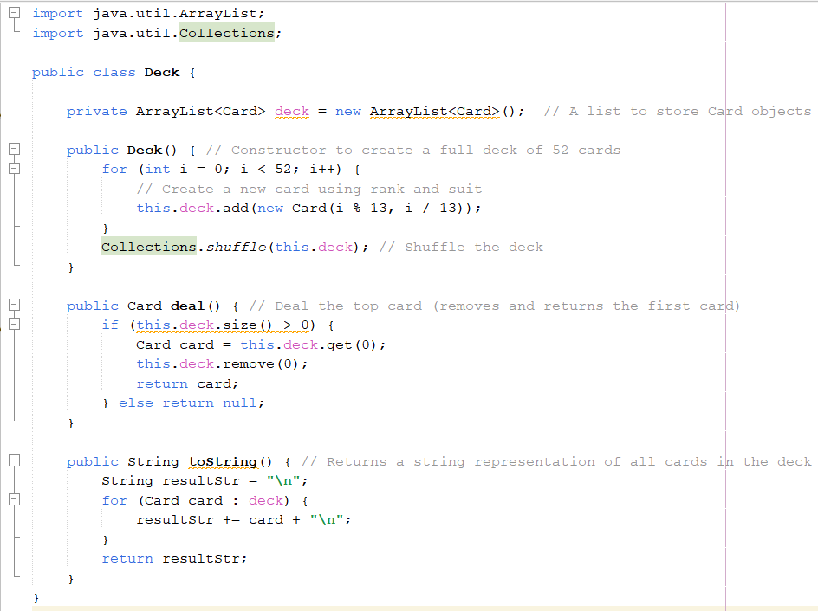
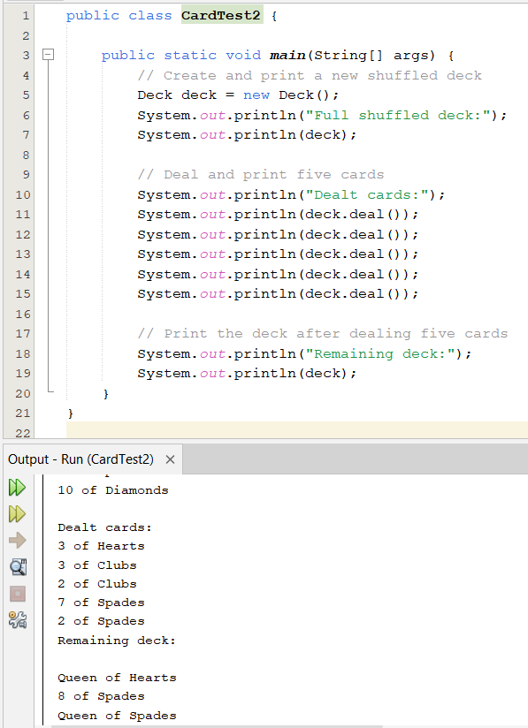
Deck.java

Slide 21
An Introduction to Sorting

Slide 22
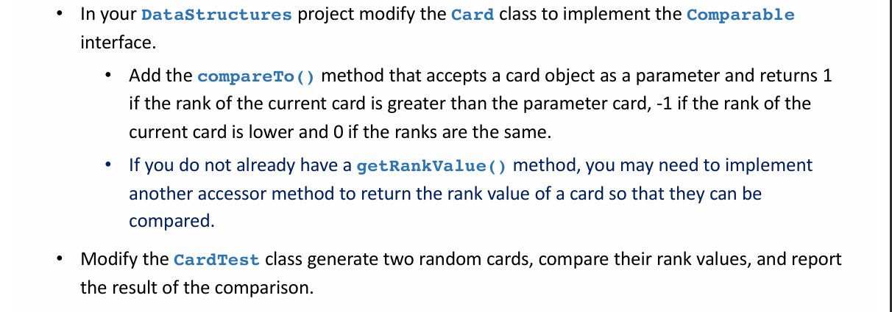
Scenario – Comparing Cards (Lab)

Slide 23
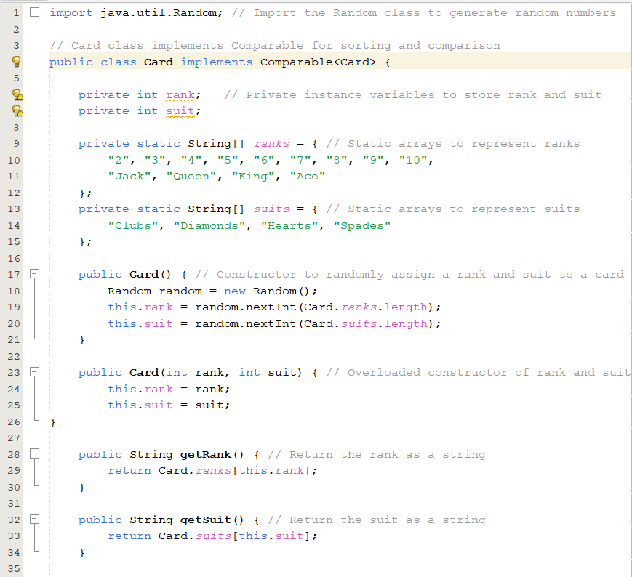
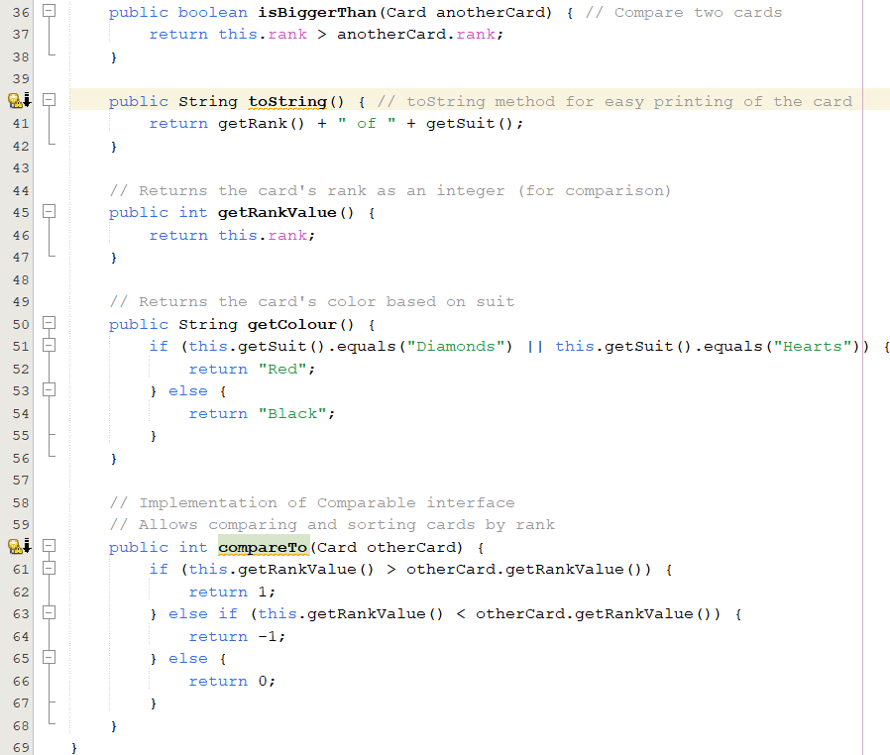
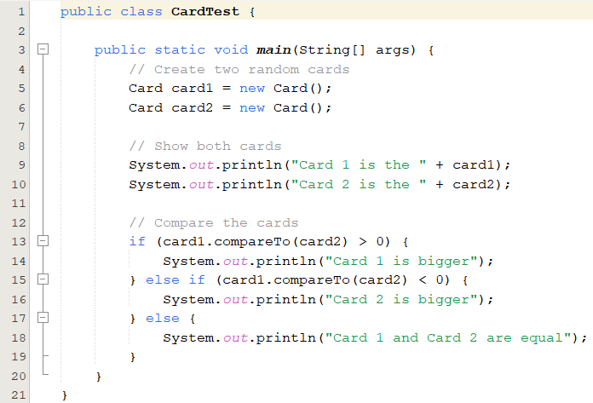
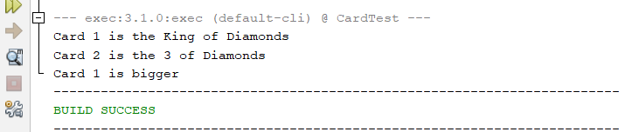

Slide 24
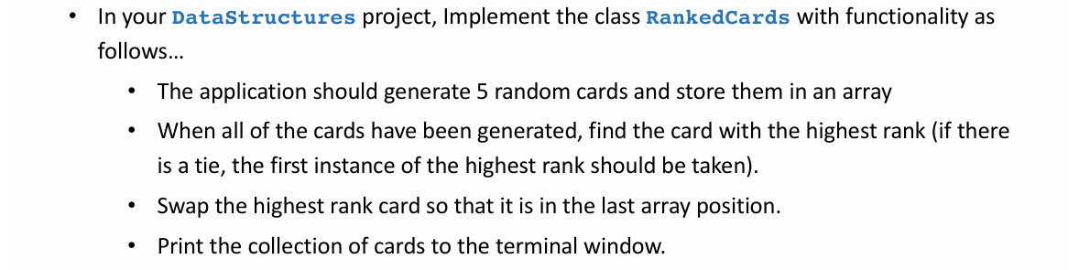
Scenario – Manipulating Cards (Lab)

Slide 26
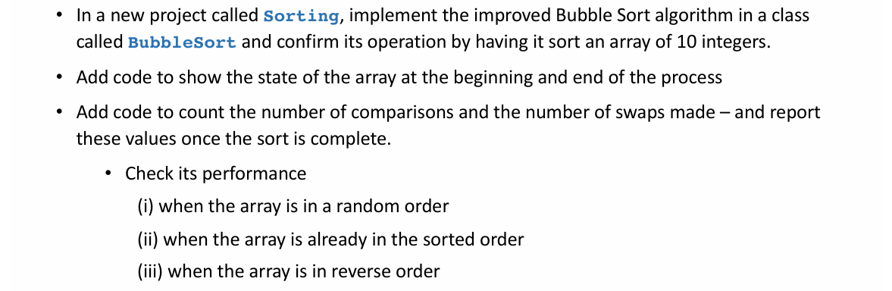
Scenario (Lab)

Slide 27
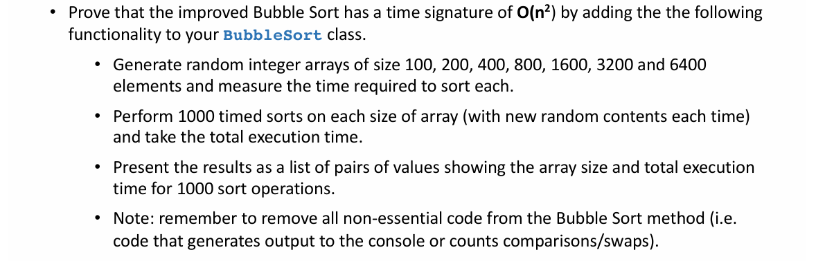
Scenario (Lab)

Slide 28
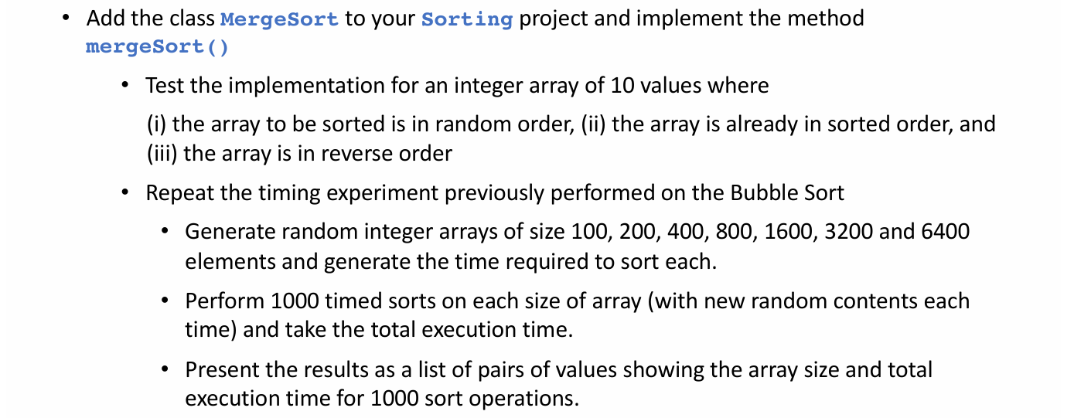
Scenario (Lab)

Slide 29
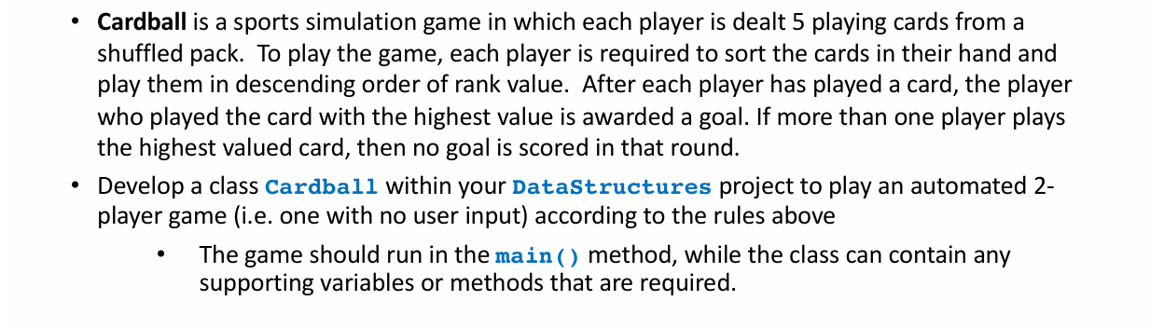
Challenge (Self Practice)

